Slide 1
Choose your Python Editor
IDLE, Jetbrains PyCharm, trinket

Slide 2
We’re going to cover…
A quick note on installing Python
The IDLE shell and editing windows
Jetbrains PyCharm
An online editor (trinket)

Slide 3
Python
Python will run on a number of different platforms
Download Python from
https://www.python.org/downloads/
This is the Python interpreter
Editors are what you write Python instructions with
So that they can be interpreted by the Python interpreter
This happens when you run your program
Editors usually provide utilities to make your life easier
Integration with other developer tools
Colour coding
Intellisense, debugging functionality
Necessary for your code to be executed (otherwise they are just text files)
(text files)
Not all editors are equal!
Find one that suits you… (or at least your current purposes)

Slide 4
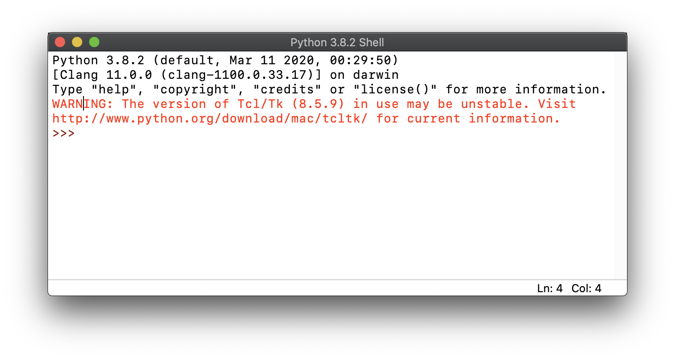
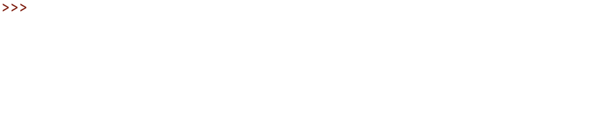
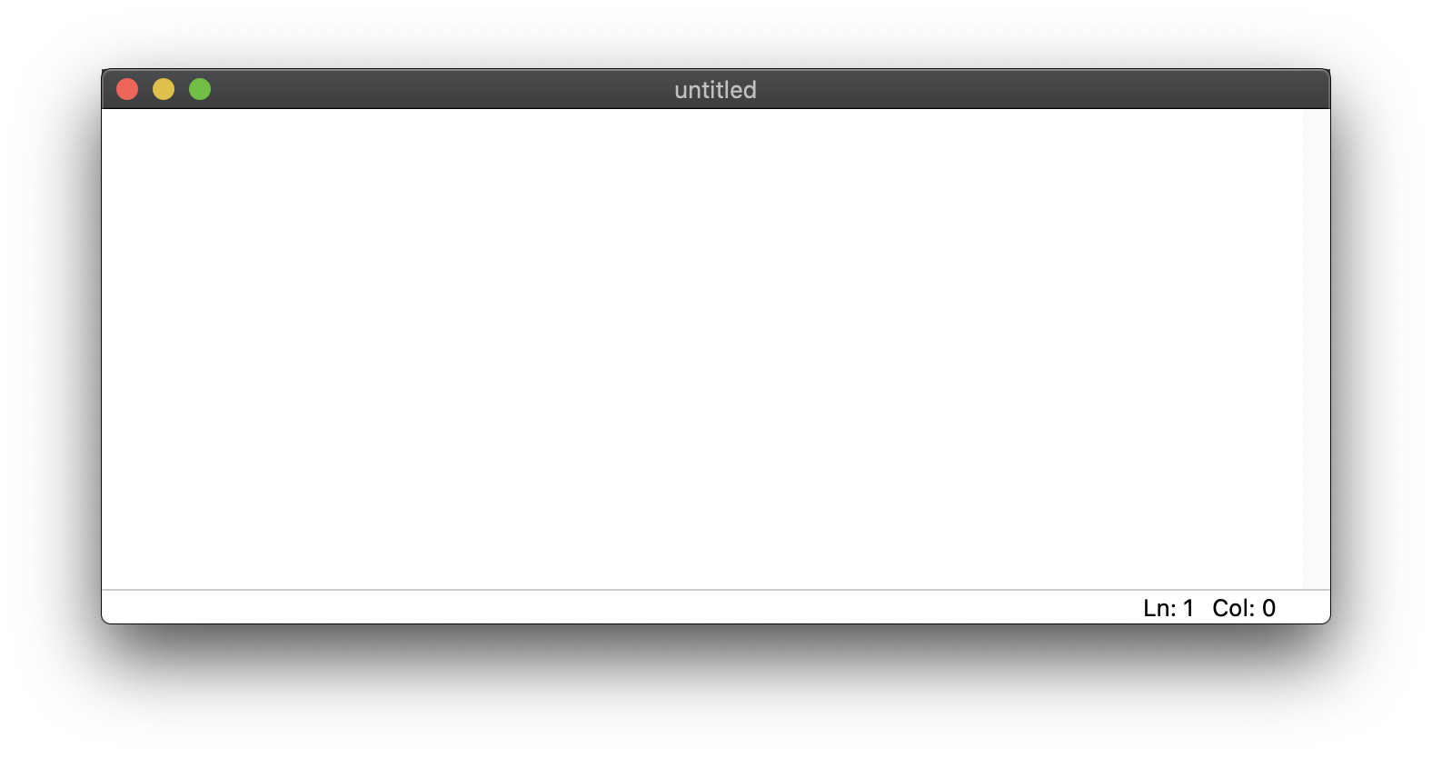
IDLE
Python 3!
1st Window (shell)
The ”help” command can be very useful
Run your program and your output will appear here!
File -> New File
2nd Window (editing)
Your code goes here!
Save the file before running it –
the .py extension will be automatically added when you name it
Current location of the cursor
IDLE comes bundled with your Python installation

Slide 5
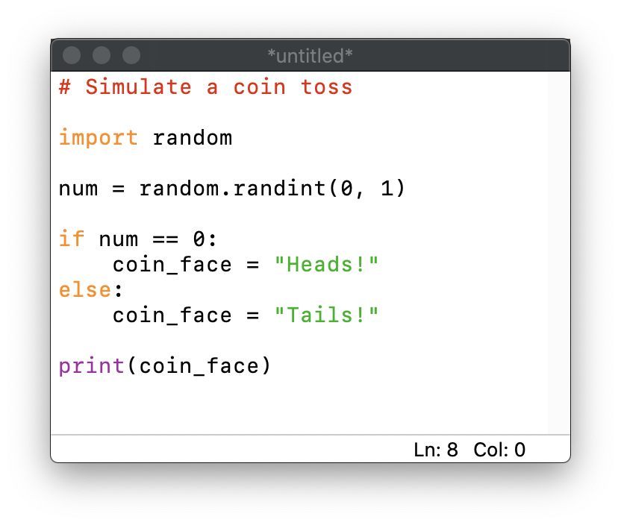
coin_toss.py
2nd Window (editing)

Slide 6
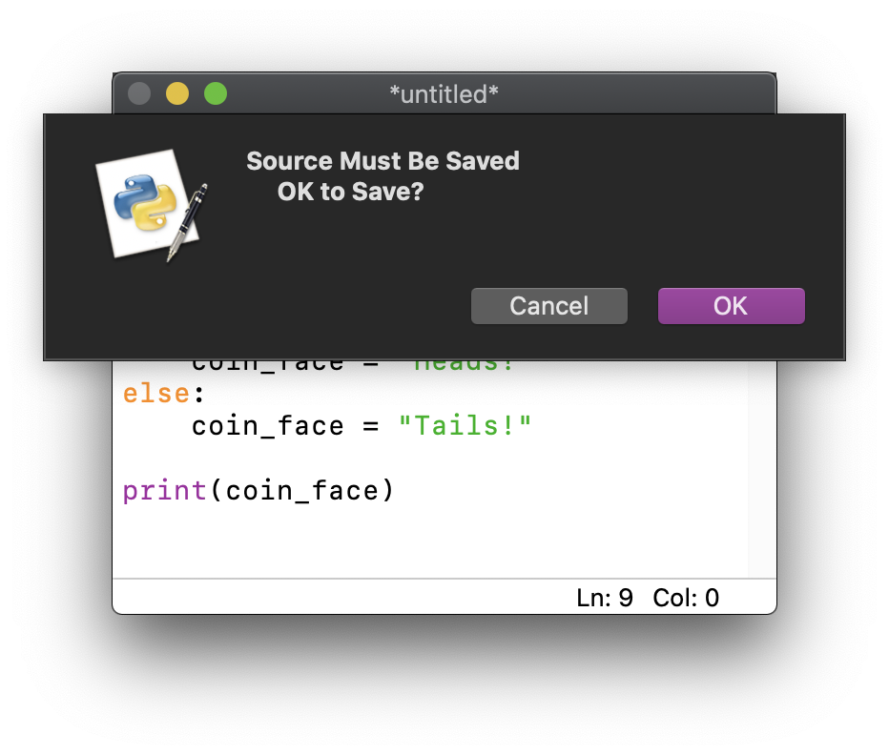
coin_toss.py
Run (F5)
2nd Window (editing)

Slide 7
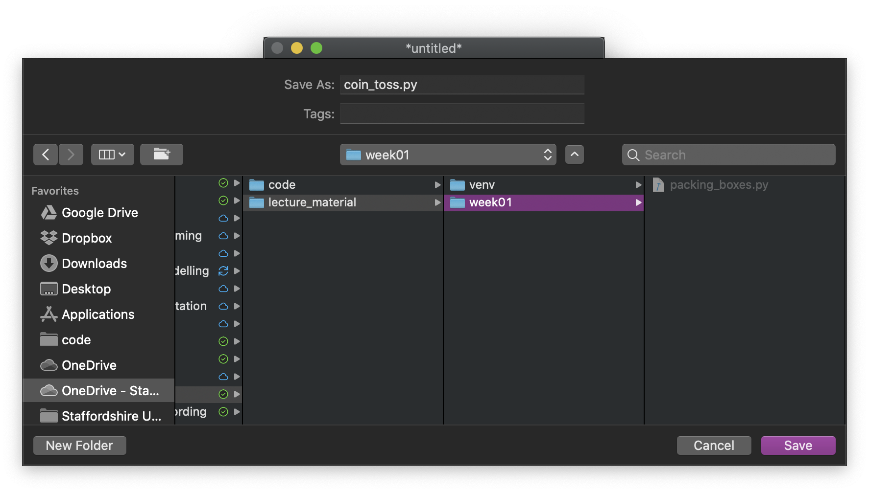
coin_toss.py
Run (F5)
OK
2nd Window (editing)
Enter “coin_toss.py” and file location

Slide 8
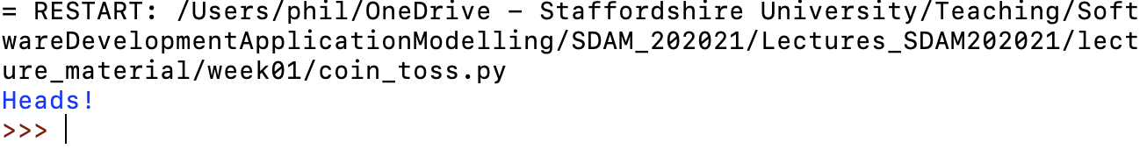
coin_toss.py
Run (F5)
OK
2nd Window (editing)
Enter “coin_toss.py” and file location
1st Window (shell)
Your original file will now have a name – and you can continue to edit it
If your program works, you should have output!

Slide 9
coin_toss.py
(new file)
Run (F5)
OK
2nd Window (editing)
(saved file)
OK
Enter “coin_toss.py” and file location
1st Window (shell)
Your original file will now have a name – and you can continue to edit it
If your program works, you should have output!

Slide 10
Python Shell
You can enter Python
code statements here – to execute immediately
It can be very useful to try stuff out
1st Window (shell)
Try typing help(random)
and then press enter…
Note: you may have to expand the results (double-click)
Have a play with it
>>> 2 + 2
>>> print(“Hi”)
>>> help(print)
>>> import datetime
>>> datetime.datetime.now().day
>>> datetime.datetime.now().minute

Slide 11
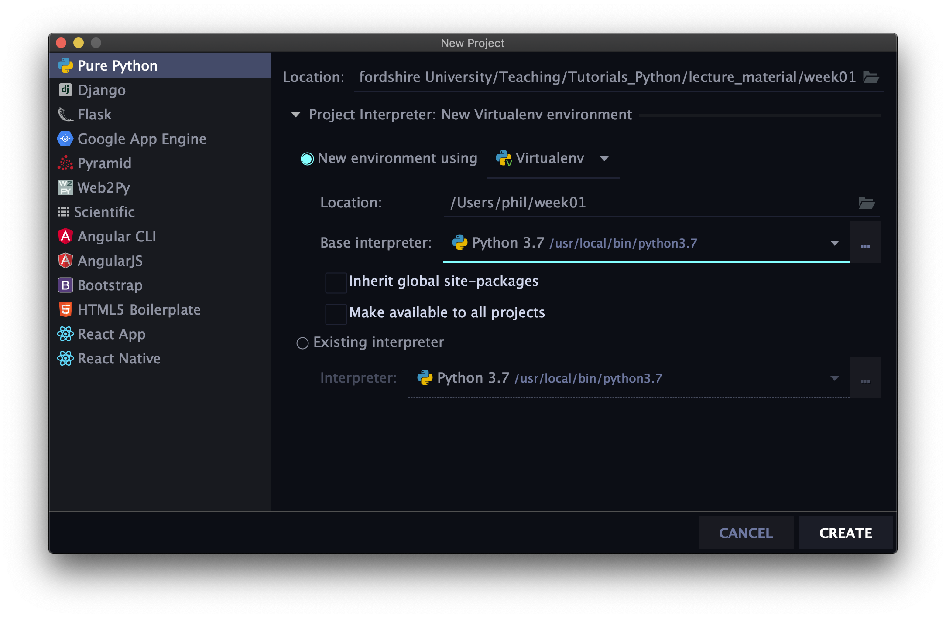
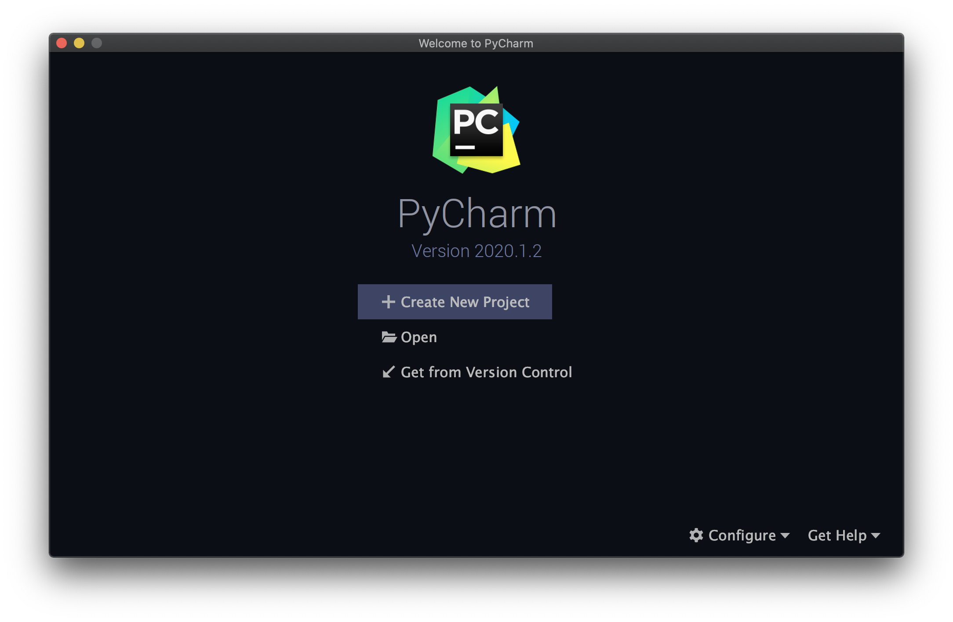
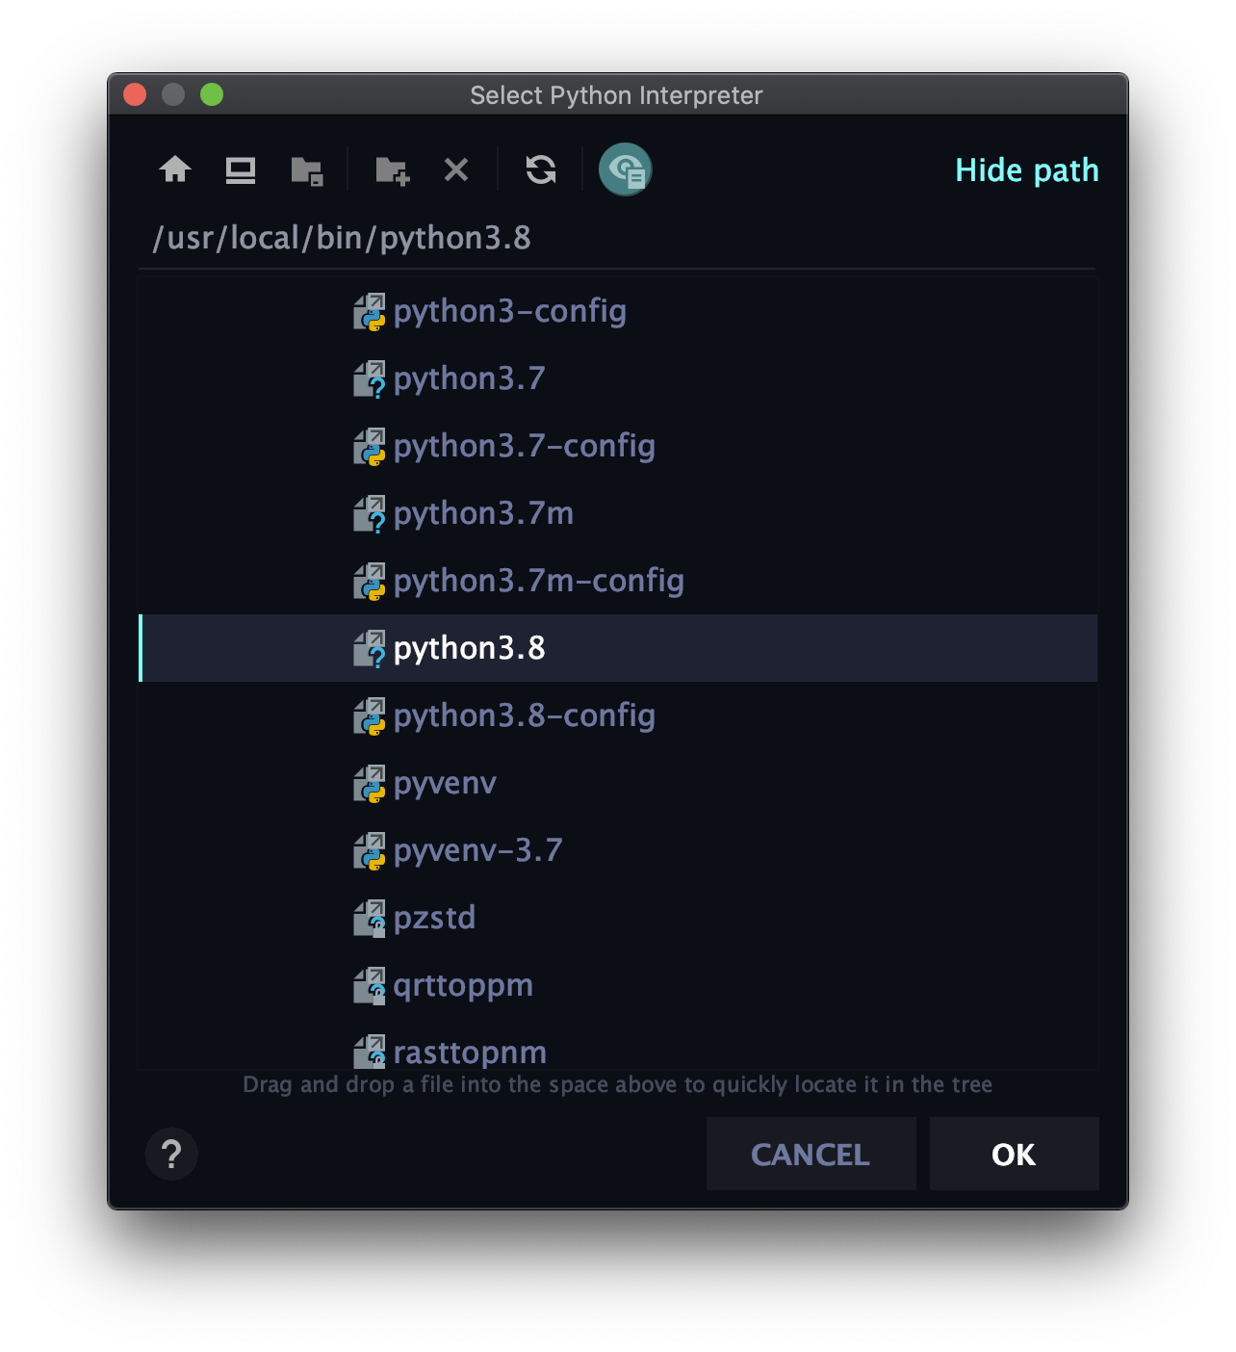
Jetbrains PyCharm
Click to expand
locating Python Interpreter
(if you need to)
(creating a new project)
Show hidden files
You have to select a Python 3 Interpreter.
Ask your tutor if you get stuck.
The path will be different on a windows machine.
Available on education license (free)
https://www.jetbrains.com/community/education/#students

Slide 12
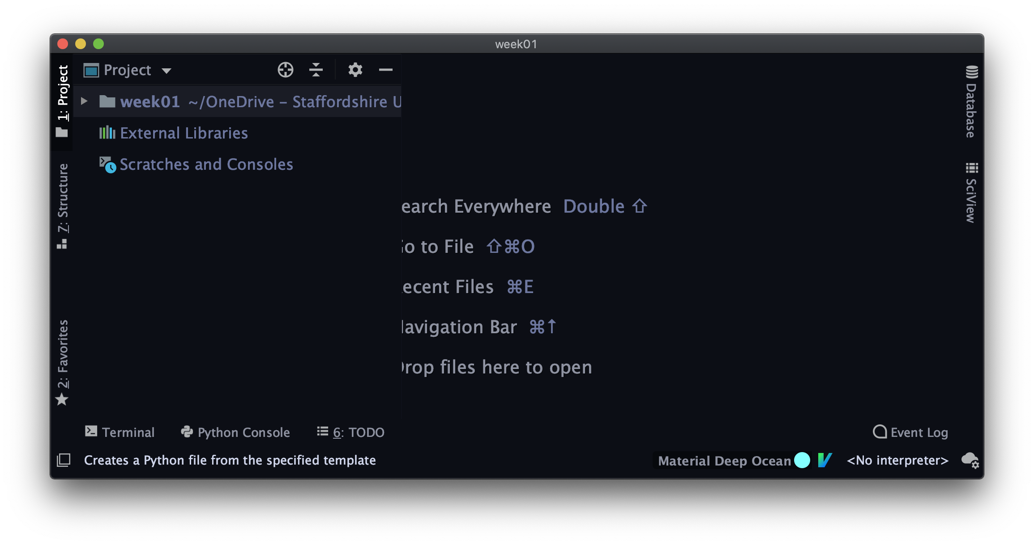
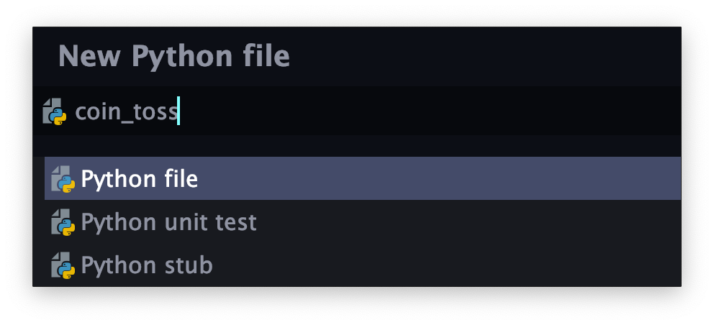
Creating coin_toss.py
Right-Click on the project root -> New -> Python File
Press enter

Slide 13
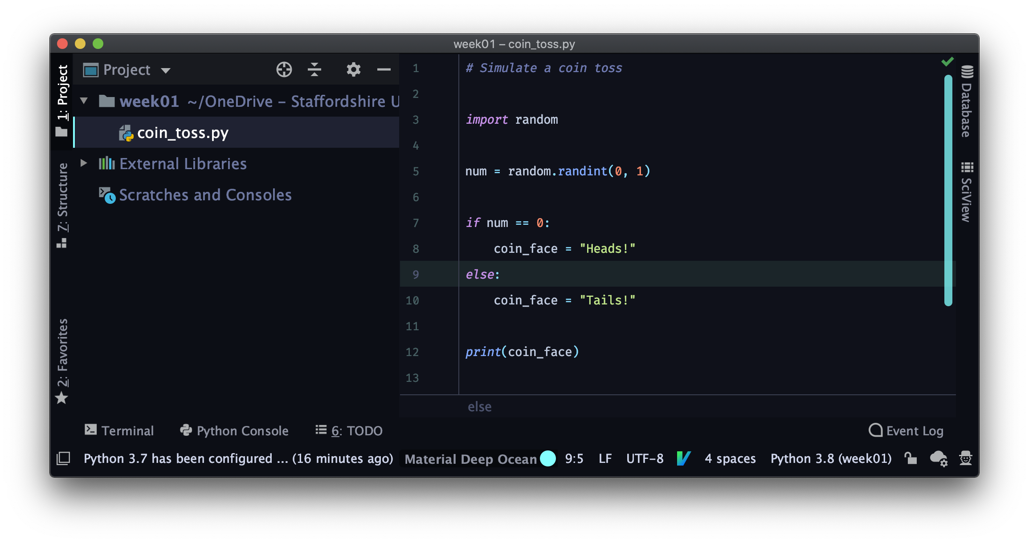
Editing and Running your Program
After editing, Right-Click on the name of the file -> Run ‘coin_toss’
Project window to explore your project’s file structure
Editor window to edit your program code
Here’s the Python console! Or you could access it via View -> Tool Windows -> Python Console

Slide 14
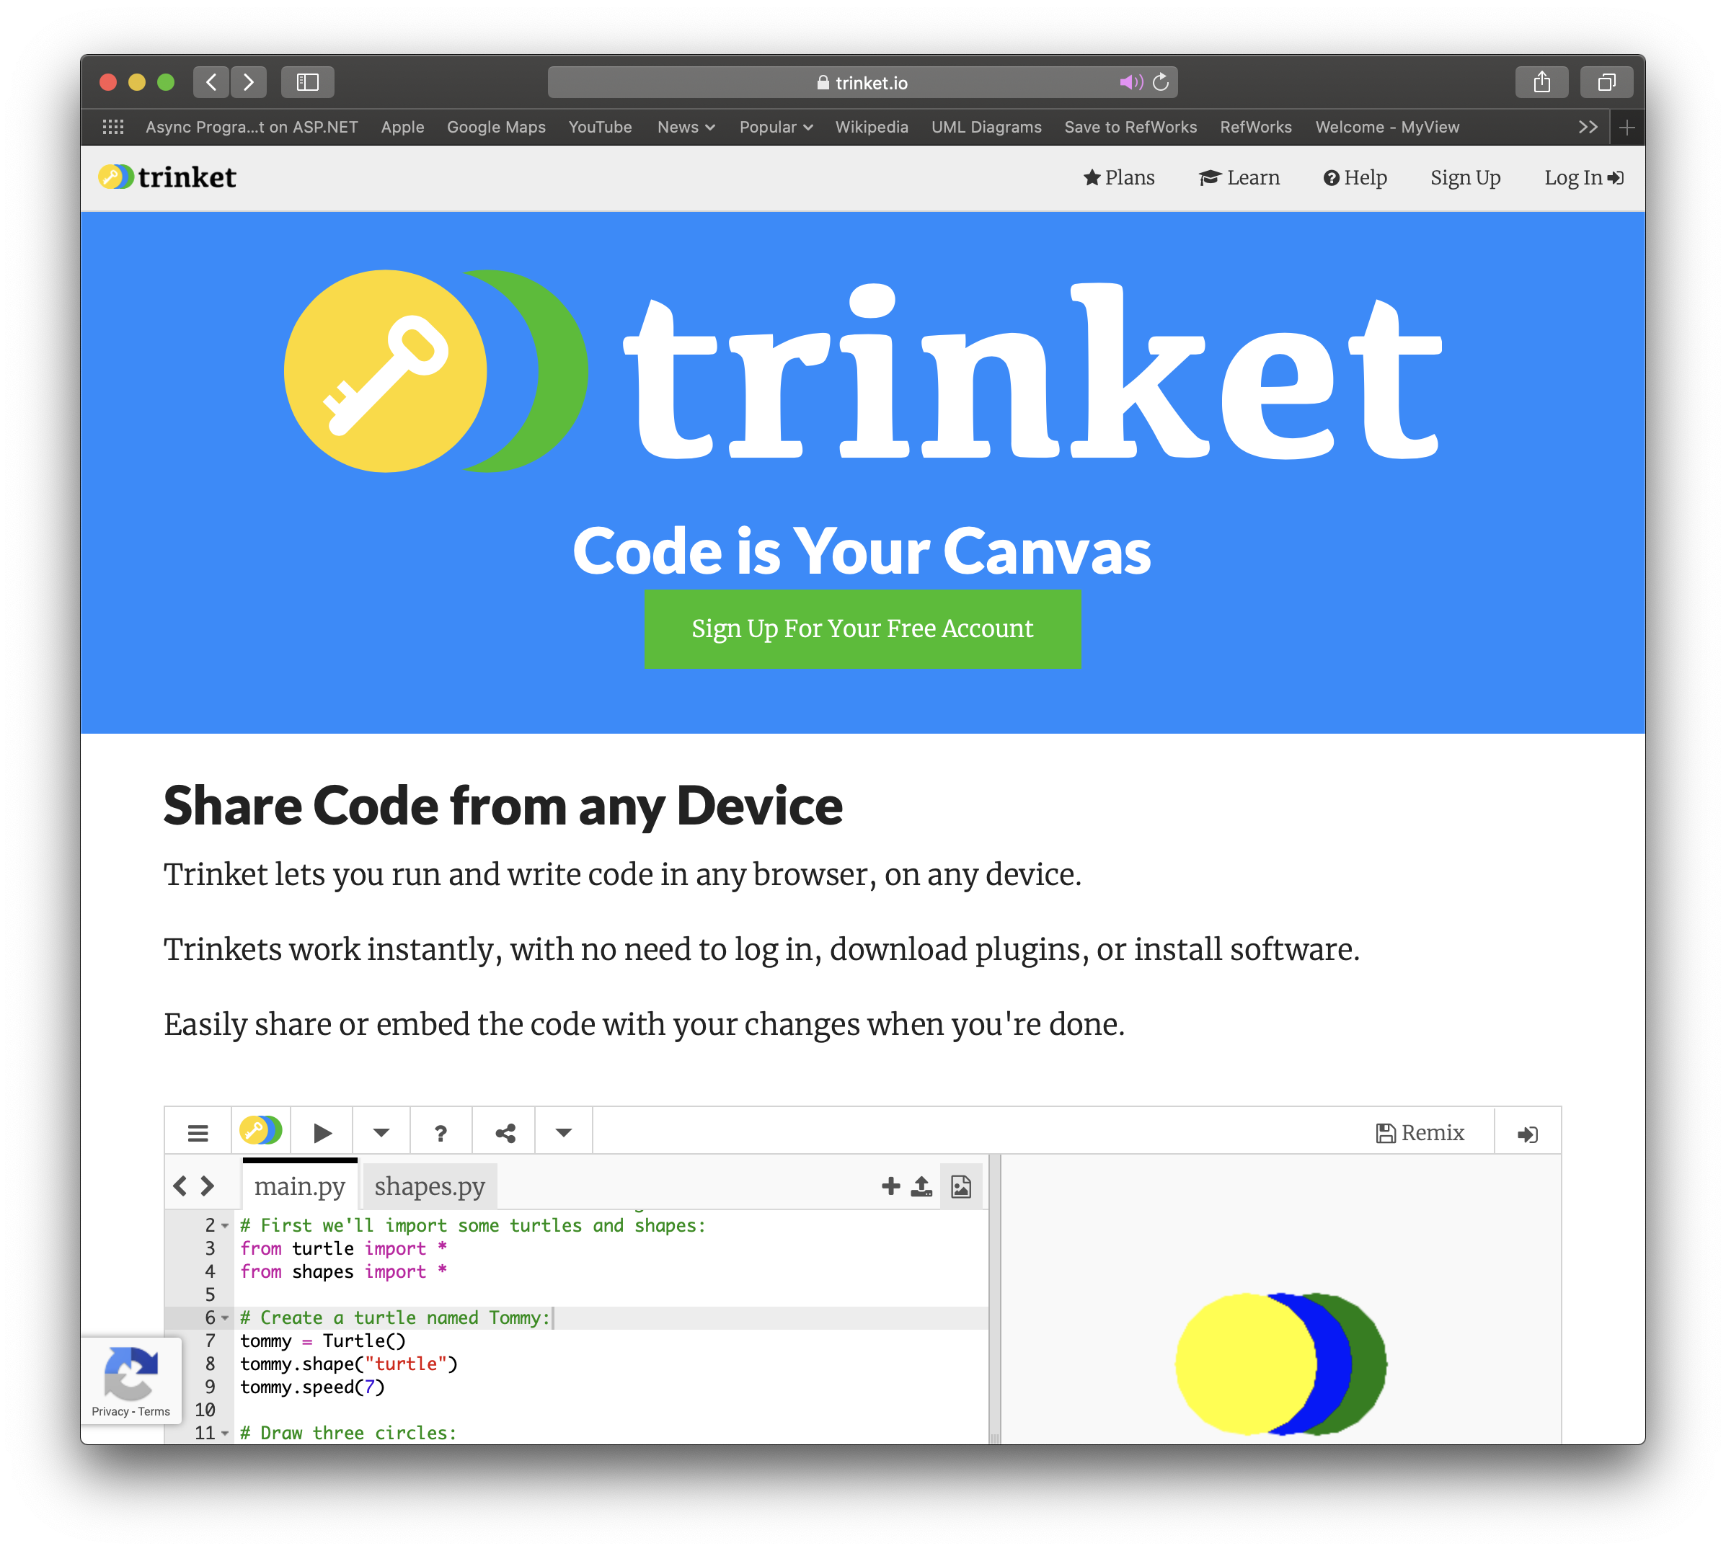
trinket
https://trinket.io
Sign up!

Slide 15
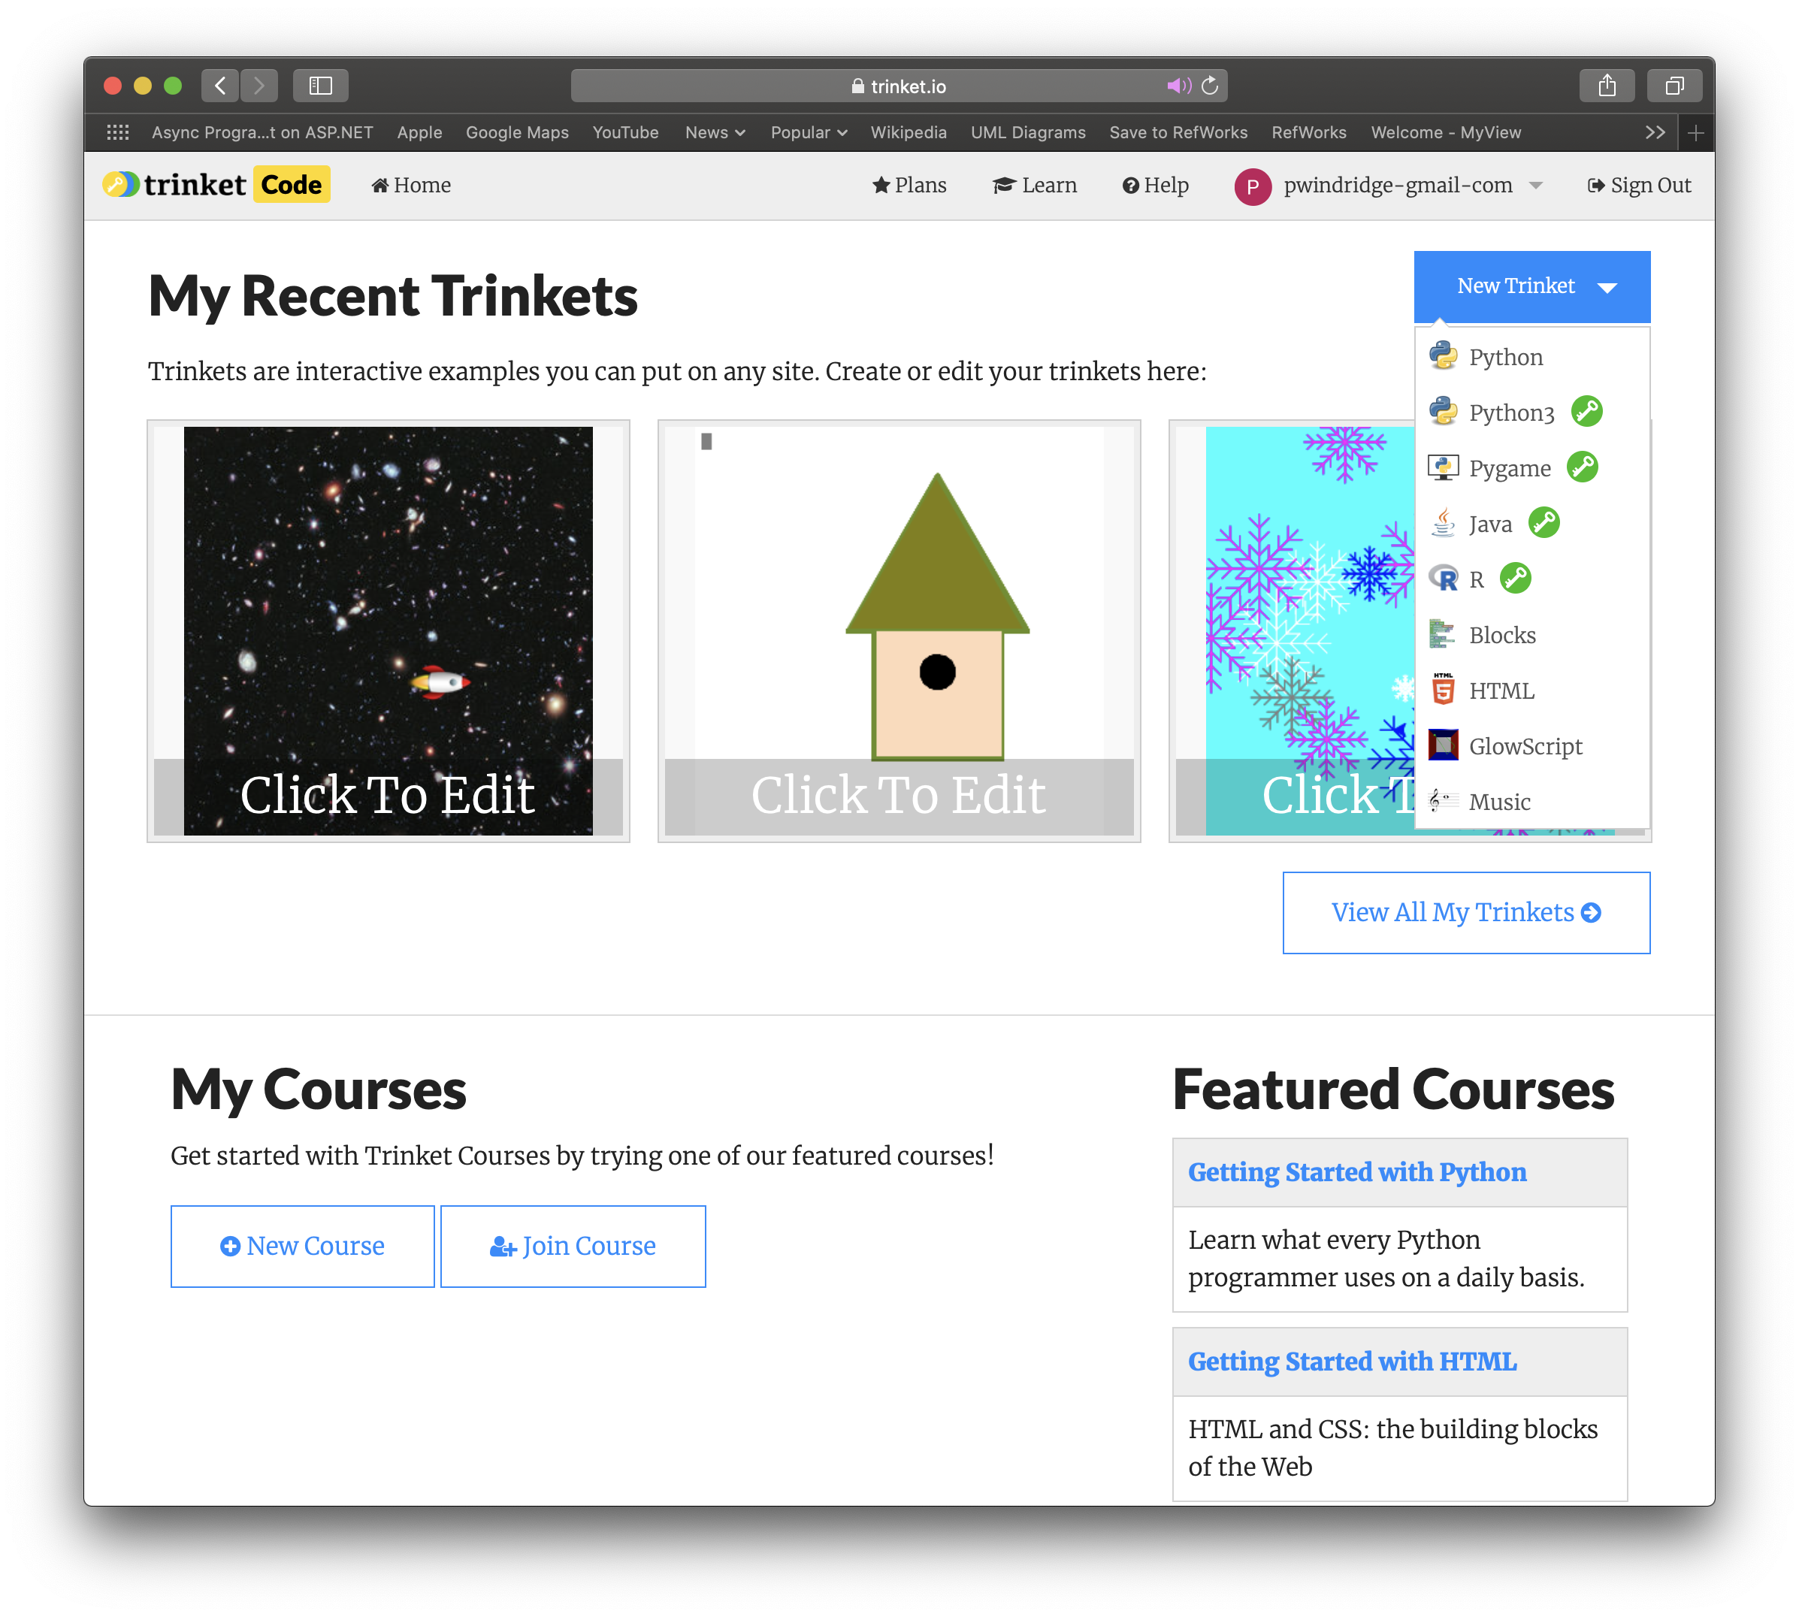
trinket
https://trinket.io
select Python3
Log In
Sign up!

Slide 16
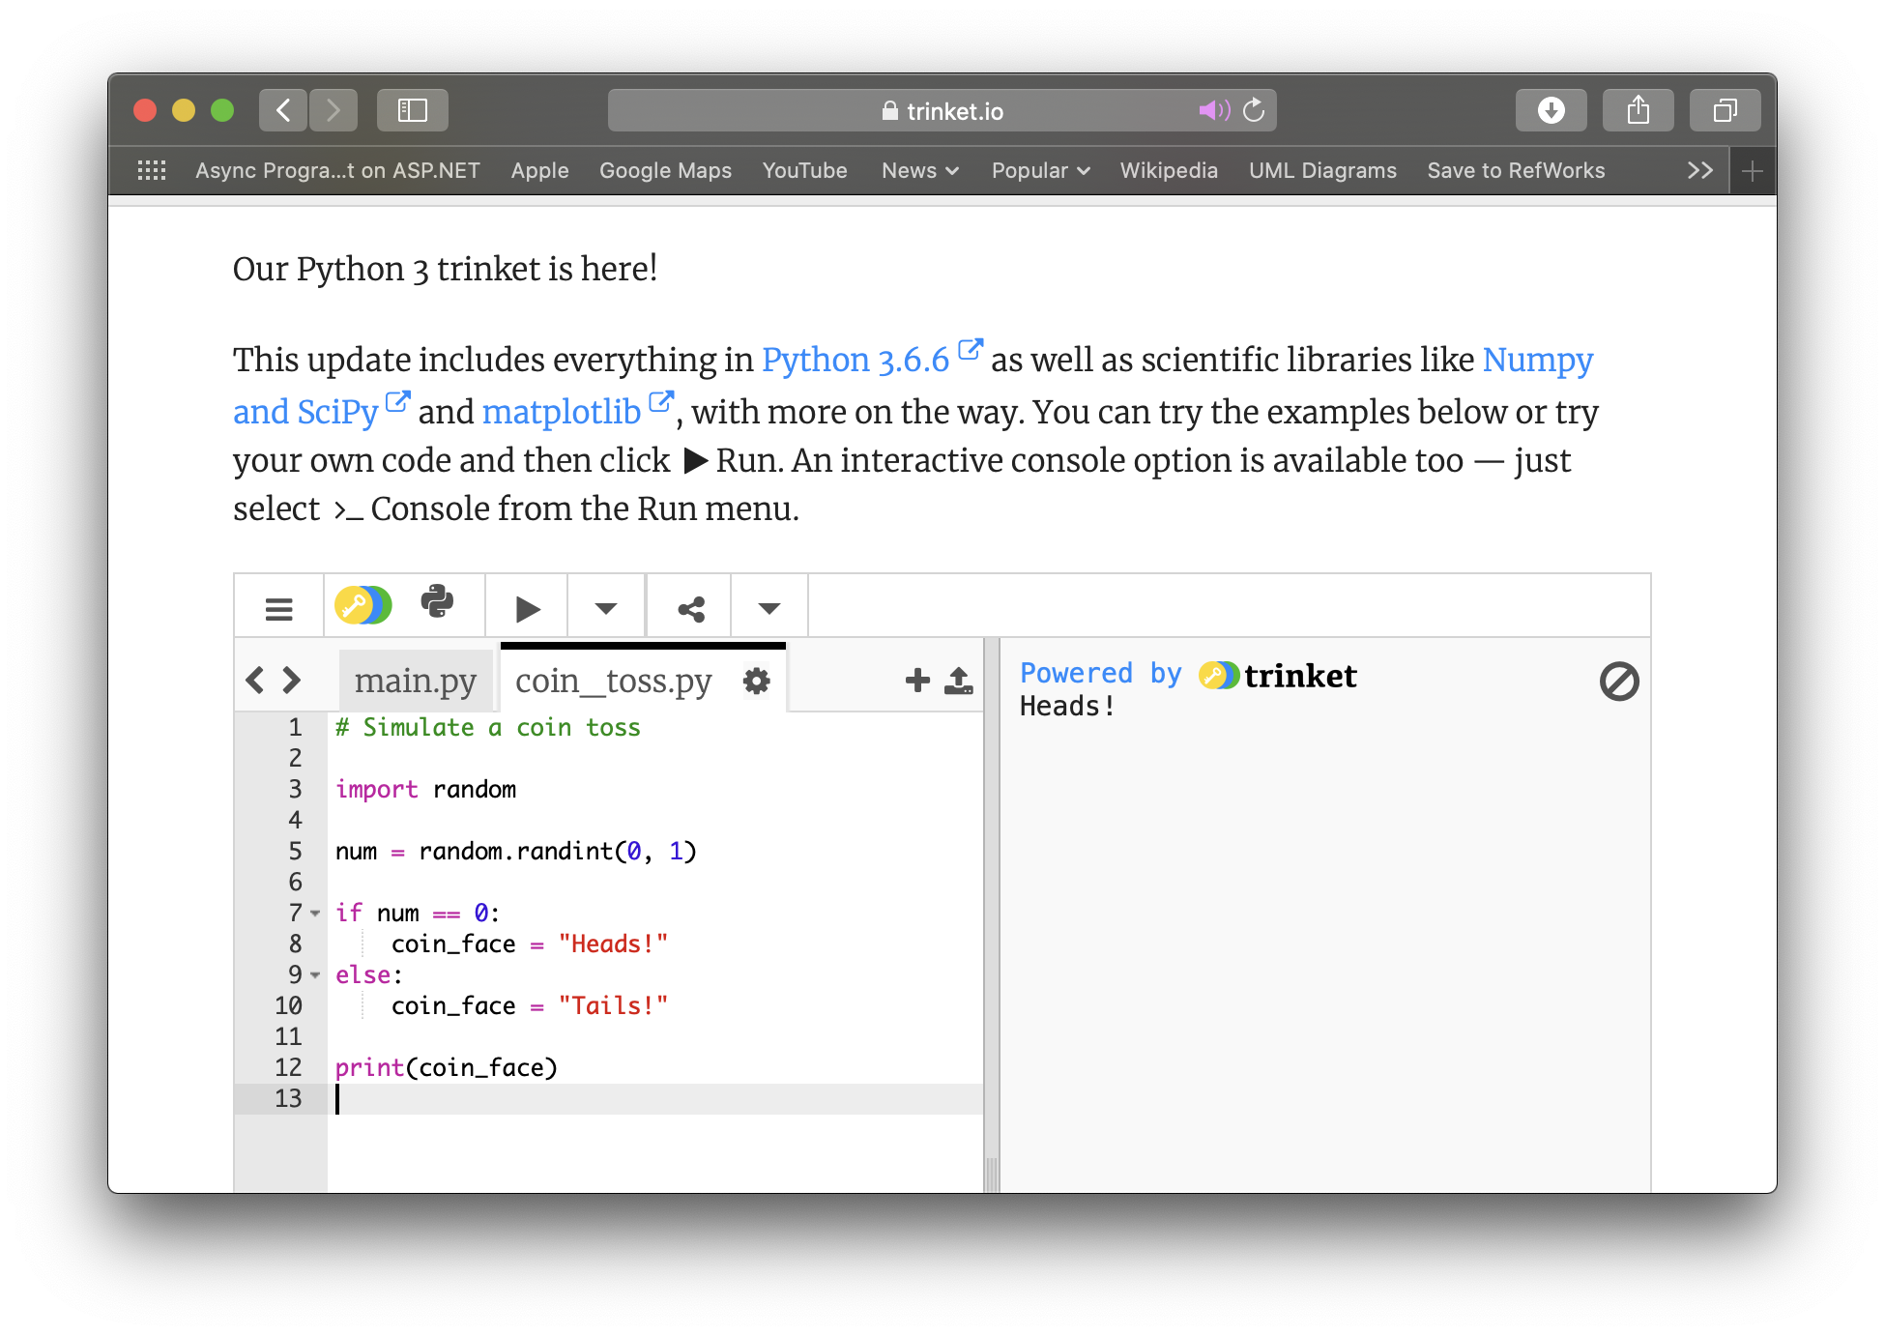
trinket
https://trinket.io
select Python3
Log In
Sign up!

Slide 17
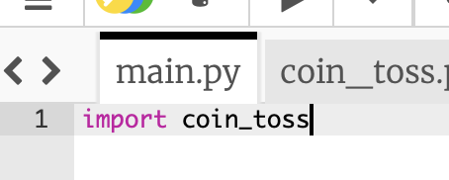
trinket
https://trinket.io
menu includes option to download file
new file
run program
put this in main so that your program runs (or put your code directly in main)
editing window
change the file name when you save it to your portfolio if you just write your code in main!

Slide 18
You should now know…
A little bit more about Python
What an editor is/does
Roughly how to start using one
…and how to get one

Slide 19
Any questions?

